Slide 1

V-REP 入门简介
virtuel robot experimentation platform
This presentation is inspired by the official V-REP presentation and the official website

Slide 2
Content
V-REP 概述
Scene Objects（场景物体）
Ca lcula tion Modules（计算模块）
Control Mechanis ms（控制机制）

Slide 3
V-REP Overview
What is it?
General purpose robot s im ula tor with integra ted developm ent environment

Slide 4
V-REP Overview
What is it?
General purpose robot s im ula tor with integra ted developm ent environment
What can it do ?
Sensors, mechanisms, robots and whole s ys tems can be modelled and s im ula ted in various ways

Slide 5
V-REP Overview
What is it?
General purpose robot s im ula tor with integra ted developm ent environment
What can it do ?
Sensors, mechanisms, robots and whole s ys tems can be modelled and s im ula ted in various ways
Typical applications ?
Fast prototyping and verifica tion Controller development
Hardware control
Simulation of factory automation systems Safety monitoring
Product presentation etc.

Slide 6







Three Central Elements
Scene Objects
Calculation Modules
Control
Mechanis ms

Slide 7









Scene Objects
Scene Objects
Ca lcula tion
Modules
Bas ic building blocks
14 different types
Can be combined with each other
Can form complex systems together with ca lcula tion modules and control
mechanis ms
Control
Mechanisms

Slide 8
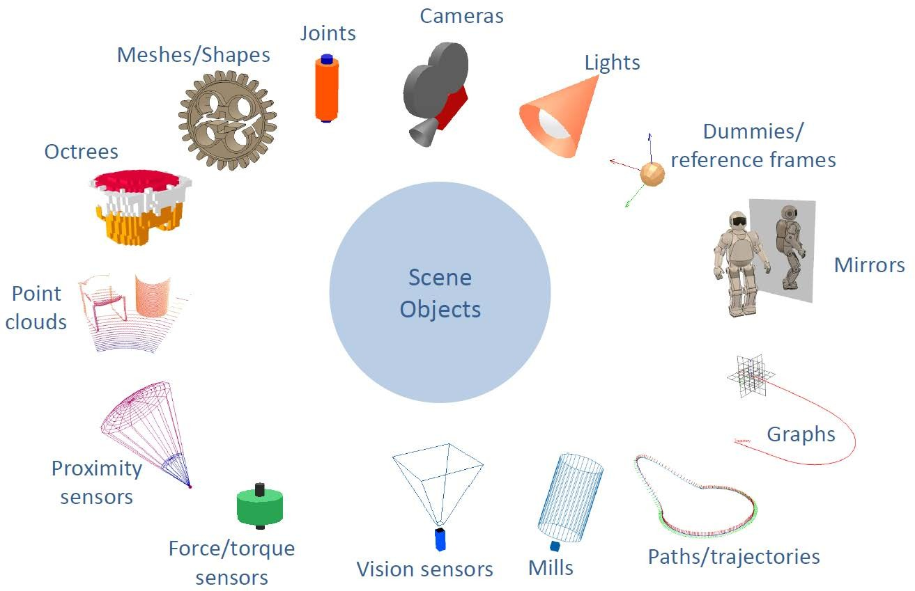

Scene Objects
Scene Objects

Slide 9

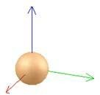
Shapes and Dummies
Shapes
Random mesh, convex mesh, primitive mesh, or heightfield mesh Can be grouped/ ungrouped (also merged)
Optim ized for fas t ca lcula tions
Dummies
Auxilia ry reference frame & helper object

Slide 10


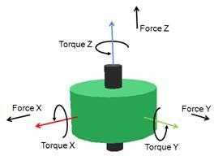
Joints and Force/ Torque Sensors
Joints
Revolute-type • Pris matic -type • Screw-type • Spherical-type Velocity, pos ition, spring/ damper or force controlled
Behavior is controlled by phys ica l engine Easy to do inverse kinematics
Force/ Torque Sensors
Measures force and torque Can conditiona lly break apart
Us ed to ‘glue’ rigid parts together
(not as s trong as grouping, but keeps individua l dynamics )

Slide 11


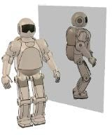
Cameras, Lights, and Mirrors
Cameras
Perspective / orthographic projection Tracking & automatic view-fitting
function
Lights
Spotlight / directiona l / omnidirectiona l
Mirrors
Mirror or scene / object clipping function

Slide 12
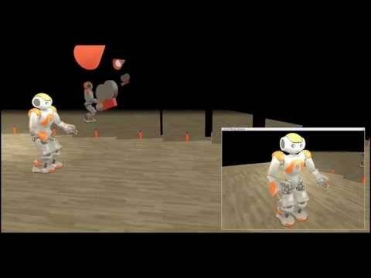
Cameras, Lights, and Mirrors

Slide 13
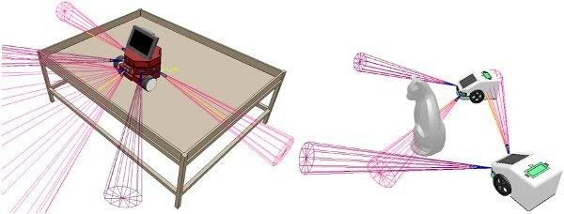
Proximity Sensors
More than s im ple ray-type detection Configura ble detection volum e
Can be used to model almost any type of proxim ity sensor, from ultrasonic to infrared, and so on.

Slide 14
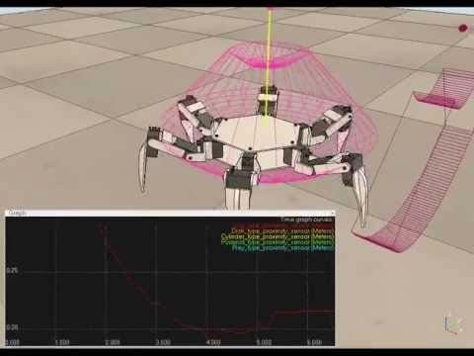
Graphs
Time graphs • X/ Y graphs • 3D curves • Can be exported
Us eful debugging tool!

Slide 15
Vision Sensors
Integra ted image processing • Ray-tra ced rendering a ls o ava ila ble

Slide 16
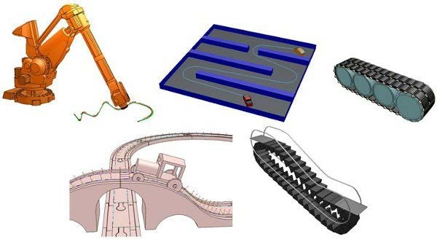
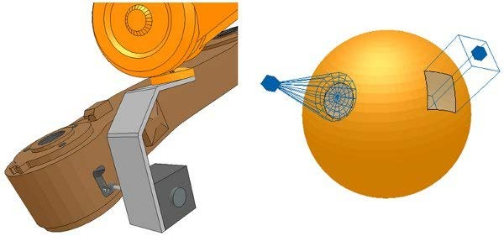
Paths and Mills
Paths
6 dim . tra jectory definition Generate a path from the edge
of a shape.
Mills
Custom iza ble cutting volum e Cuts shapes (i.e. meshes)

Slide 17
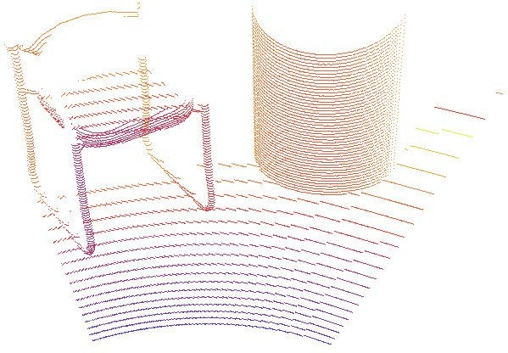
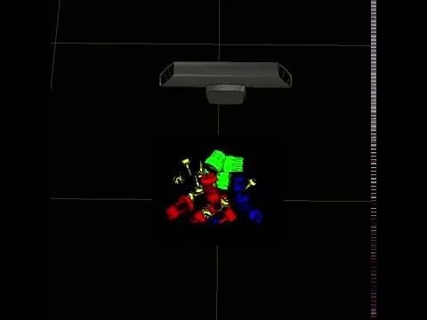
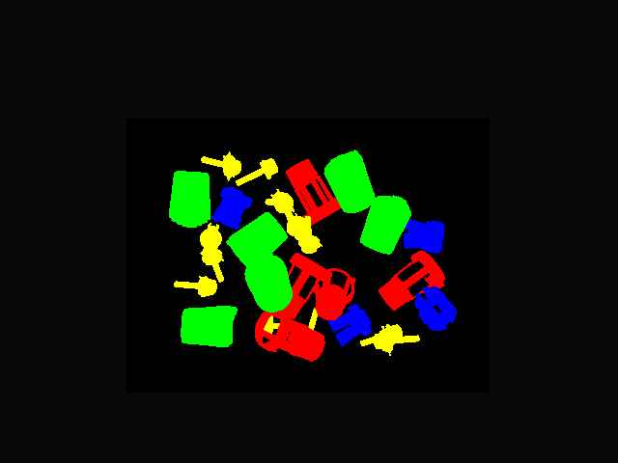
Octrees and Point Clouds
Point Clouds
Point container

Slide 18
Calculation modules
Scene Objects
Ca lcula tion
Modules
5 bas ic a lgorithm s
Can be combined with each other
Control
Mechanisms

Slide 19
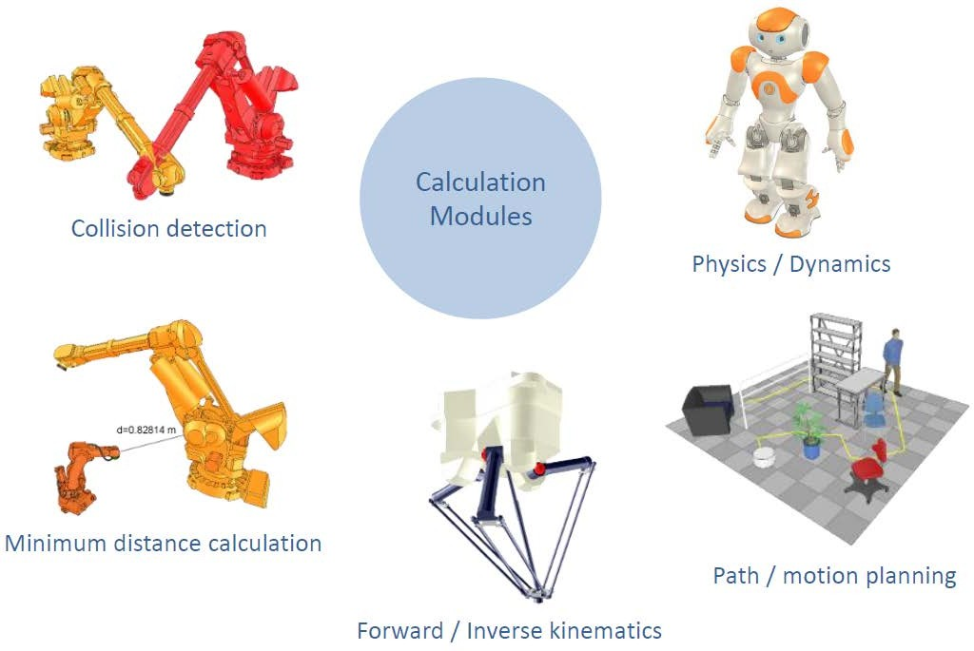

Calculation modules
Ca lcula tion
Modules

Slide 20
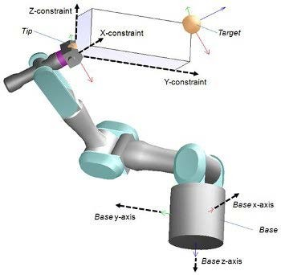
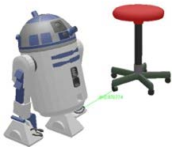
Inverse/ forward kinematics & Minimum Distance Calculations
Inverse/ forward kinematics
Any mechanism: redundant, branched, clos ed, etc.
Da mped / undamped resolution
Weighted resolution • Conditiona l resolution Obstacle a voidance
Minimum Distance Calculations Any mesh • Any point cloud • Any individua l point

Slide 21
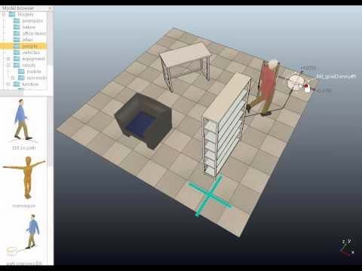
Collision Detection and Path Planning
Collision Detection
Any mesh • Any point cloud • Any individual point
Path Planning
Planning tasks in 3D- space, and in 2D-s pace for vehic les with non-
holonom ic motion constraints.

Slide 22
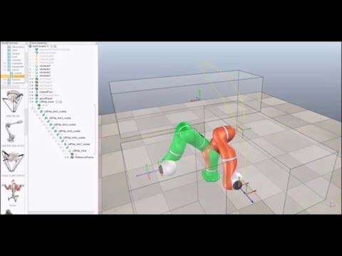
Collision Detection and Path Planning
Collision Detection
Any mesh • Any point cloud • Any individual point
Path Planning
Planning tasks in 3D- space, and in 2D-s pace for vehic les with non-
holonom ic motion constraints.

Slide 23
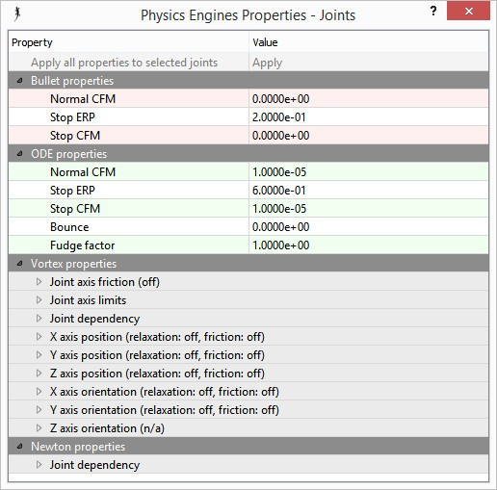




Dynamics / Physics
4 physics engines:
Bullet Phys ics
Open Dyna mics Engine (ODE)
Vortex Dyna mics
Newton Dyna mics
Sim ple switching
Dyna m ic partic les to s im ula te a ir or water jets

Slide 24
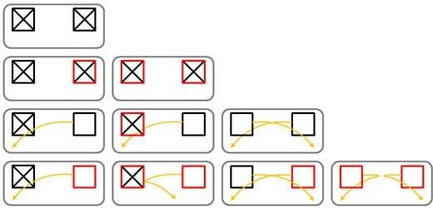
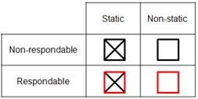
Dynamics
Static/ non-s tatic shapes
respondable/ non-res pondable shapes (masks)

Slide 25
Control Mechanisms
Scene Objects
Ca lcula tion
Modules
6 methods or interfaces
7 languages
All methods can be used at the same time, and even work hand-in-ha nd
Control
Mechanisms

Slide 26












Control Mechanisms
Embedded Scripts
Remote API clients
Control
Mechanis ms
Plugins
ROS nodes
Add-ons

Slide 27








Control Mechanisms
Embedded Scripts
Remote API clients
Local Interface
Same process
Remote Interface Different process / hardware
Plugins
ROS nodes
Add-ons

Slide 28




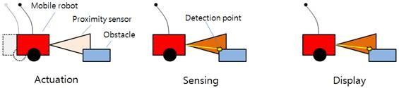
Control Mechanisms
Over 500 API functions
(Extenda ble)
Can be attached to any scene object Many Lua extens ion libra ries ava ila ble
Threaded or non-threa ded
Va rious types: ma in script, child scripts , ca llba ck scripts
(e.g. custom joint controllers)
Lua interface
Lightweight and easy to program (child scripts )
→ Initialization • Actua tion • Sensing • shut down
Extremely portable solution
Embedded Scripts
Plugins
Add-ons

Slide 29
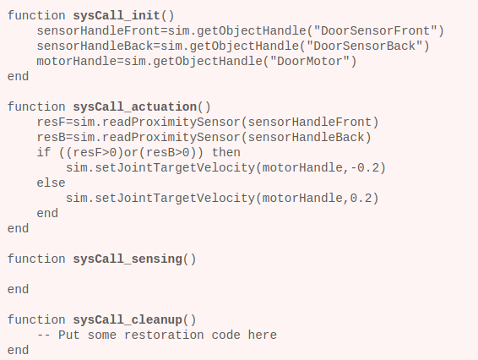
Control Mechanisms
Embedded Scripts
Non-threa ded child script
Plugins
Add-ons

Slide 30
Control Mechanisms
Over 500 API functions. Extendable C/ C++ interface
Us ed to provide V-REP with a special functiona lity requiring
either fast ca lculation capability (s cripts are most of the tim e s lower than compiled languages), a specific interface to a hardware device (e.g. a real robot), or a special communication interface with the outside world
The ROS functiona lity is pla ced in a plugin
Embedded Scripts
Plugins
Add-ons

Slide 31
Control Mechanisms
Over 400 API functions. Extendable Lua interface
Can customize the s imula tor Lightweight and easy to set-up
Can s tart automatically and run in the background, or they can be called as functions
Embedded Scripts
Plugins
Add-ons

Slide 32

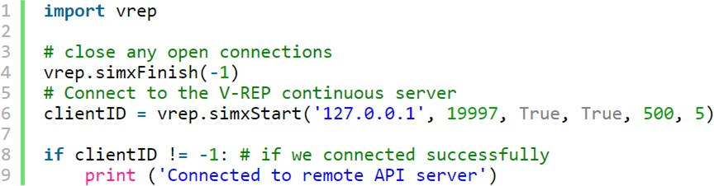
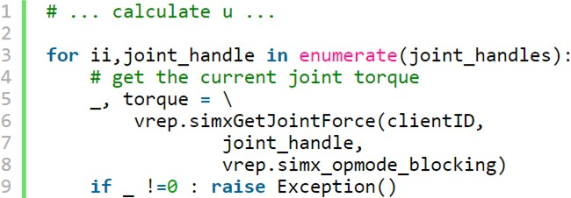
Control Mechanisms
Over 100 API functions
(Extendable)
Client (your program) - Server (v-rep plugin) relationship
C/ C++, Python, Java, Matlab, Octave, Lua & Urbi interfaces Lightweight and easy to use
Remote API clients
ROS nodes
Python Example

Slide 33

Control Mechanisms
Plugin-based
It acts as a ROS node that other nodes can communicate with via ROS services, ROS publishers and ROS subscribers
Supports all standard messages and is extendable
Generic (e.g. easy to change program from communicating with the simulation to communicating with a real robot)
I successfully compiled it with ROS Kinetic in ubuntu 16.04
Remote API clients
ROS nodes

Slide 34
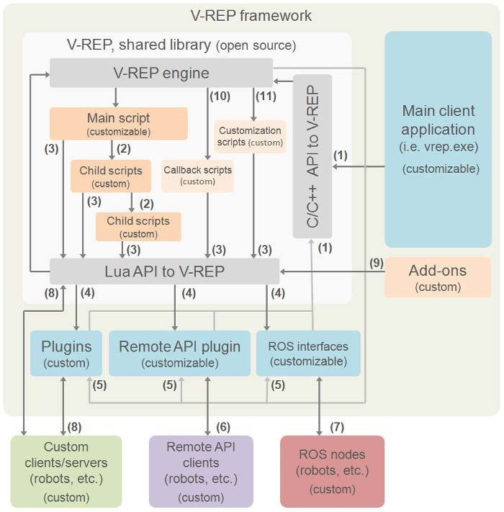
Control Mechanisms
C/ C++ API Ca lls
Cascaded Child script execution
LUA API calls
Custom LUA API callbacks
V-REP event callbacks
remote API function ca lls
ROS transit
custom communica tion
s ocket, s erial, pipes , etc.
Add-on calls to LUA API
Script ca llba ck ca lls

Slide 35
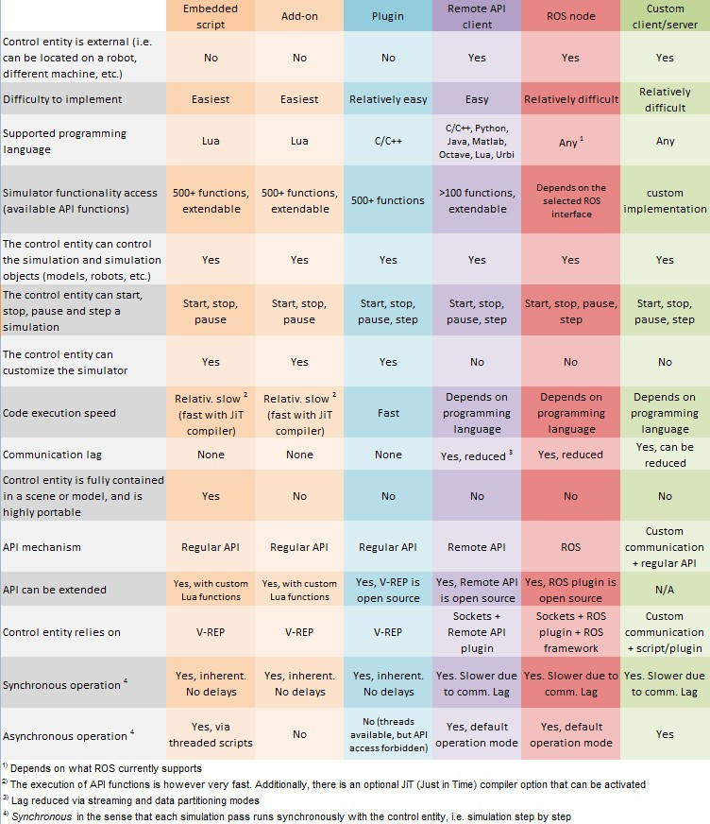
Control Mechanisms
If in doubt, use their website!
http:/ / www.coppeliarobotics .com

Slide 36
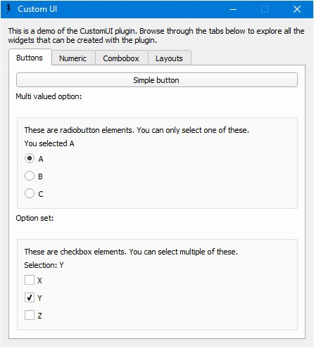
Other features - Custom User Interfaces (QT-Based)

Slide 37
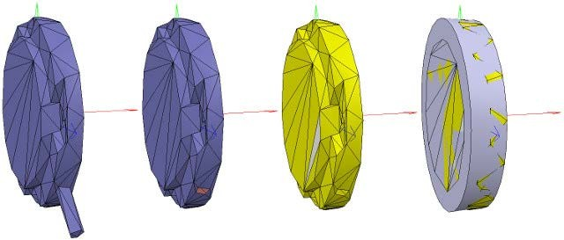
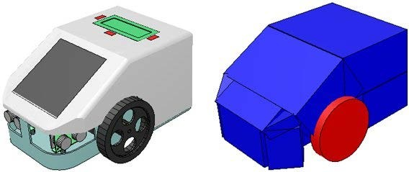
Other features - Mesh Edit Modes
Triangle, vertex or edge edit mode
Modify meshes (adjust vertices, add/ remove triangles)
Semi-automatic prim itive shape extraction function
Triangle, vertex or edge extra ction
Mesh decomposition
Convex decomposition
Convex hull extraction
Mesh decim ation

Slide 38
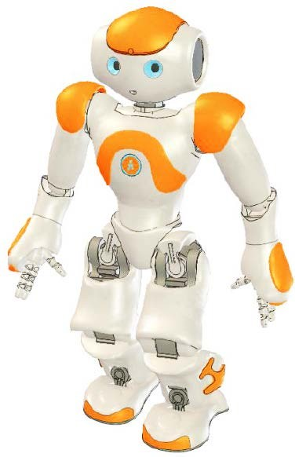
Other features
Headles s mode support (i.e. via command line)
Import formats: OBJ , STL, 3DS, DXF, COLLADA & URDF
Model browser and scene hierarchy
Multilevel undo / redo
Movie recorder (w. ray tracing)
Sim ula tion of pa int or welding seams
Static & dynamic textures
Exhaustive documentation
Etc.

Slide 39
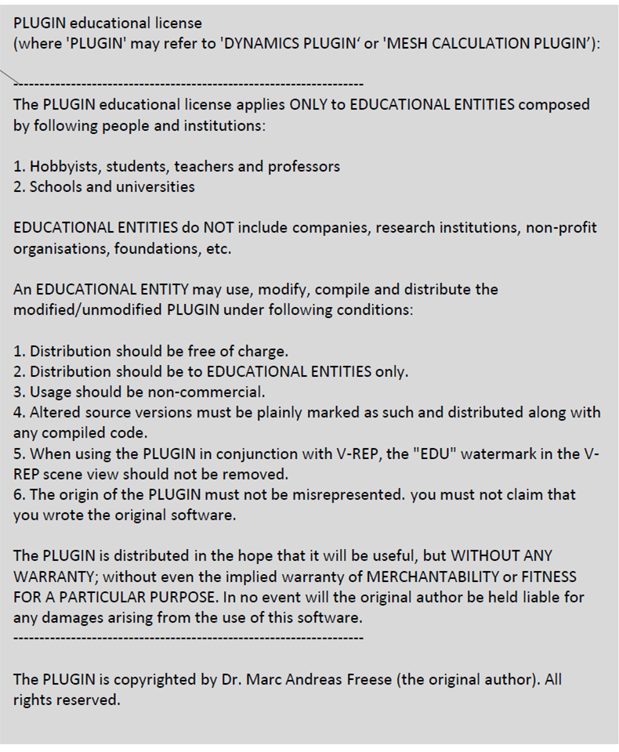
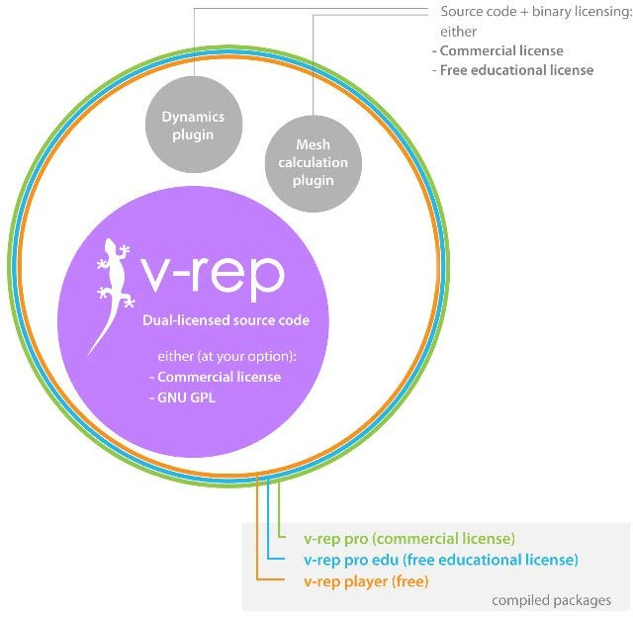
V-REP Source Code Licens ing

Slide 40




Res ources
V-REP webs ite: www.coppeliarobotics .com
V-REP us er manual: www.coppeliarobotics .com/ helpFiles / V-REP forum: www.forum.coppeliarobotics .com
V-REP YouTube channel: VirtualRobotPlatform V-REP Twitter account: coppelia Robotic

Slide 41

Starting your own project in GoRobots

Slide 42
Starting your own project in GoRobots
1. As k for membership in ENS group on GitLa b (Koh, J an-Matthias, or Me)

Slide 43
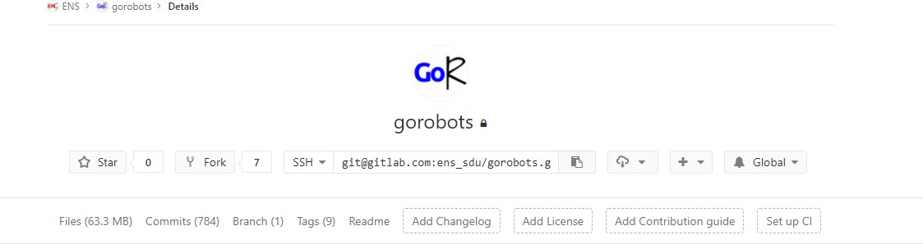
Starting your own project in GoRobots
As k for membership in ENS group on GitLa b (Koh, J an-Matthias, or Me)
Fork your version of GoRobots
Press this

Slide 44
If you forked later than 08.47 this morning do this!
Configure a remote that points to the upstream repository in Git
$ git remote add upstream git@gitlab.com:ens_sdu/ gorobots.git
Fetch the branches and their respective commits from the upstream repository
$ git fetch upstream
Check out your fork's local master branch.
$ git checkout master
Merge the changes from upstream/ master into your local master branch (Sync.)
$ git merge upstream/ master
Check for merge conflicts with (you may need to ins tall meld)
$ meld .
No Important Changes (Check with meld)? → $ git reset --hard

Slide 45
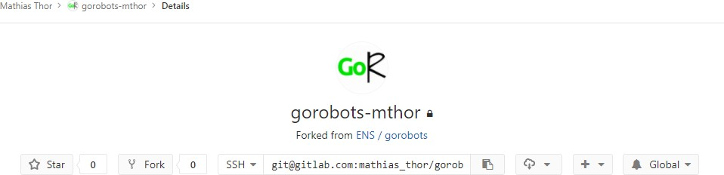
Starting your own project in GoRobots
As k for membership in ENS group on GitLa b (Koh, J an-Matthias, or Me)
Fork your version of GoRobots
Clone your fork to your Pc
git clone “this address”

Slide 46
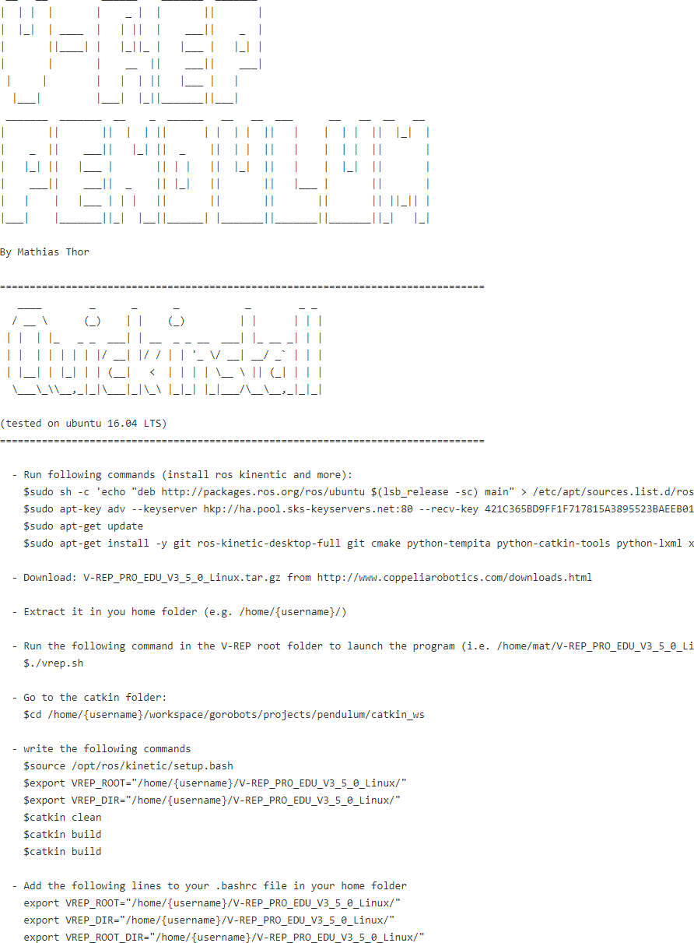
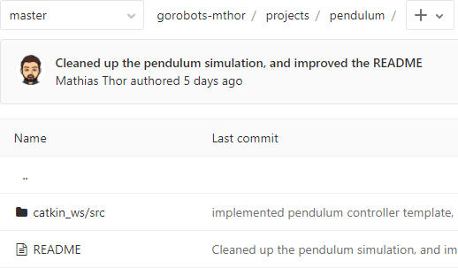
Starting your own project in GoRobots
As k for membership in ENS group on GitLa b (Koh, J an-Matthias, or Me)
Fork your version of GoRobots
Clone your fork to your Pc
Get pendulum s imula tion up and running by following the guide in the readme file
Please write me on mathias@mmmi.sdu.dk if you find any errors in the guide

Slide 47
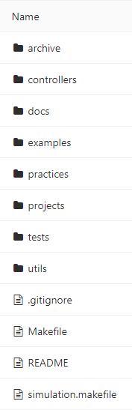
Starting your own project in GoRobots
1. As k for membership in ENS group on GitLa b (Koh, J an-Matthias, or Me)
Fork your version of GoRobots
Clone your fork to your Pc
Get pendulum s imula tion up and running by following the guide in the readme file
Your controller here →
e.g. /controllers/pendulum/pendulumController.cpp
5. Start your own project and use the following s tructure
Your makelistcatkin and child script here →
e.g. /projects/pendulum/catkin_ws/src/...
Your v-rep sim (.ttt) in v-rep_simulations in here →
e.g. /utils/v-rep_simulations/pendulum/ pendulum.ttt

Slide 48
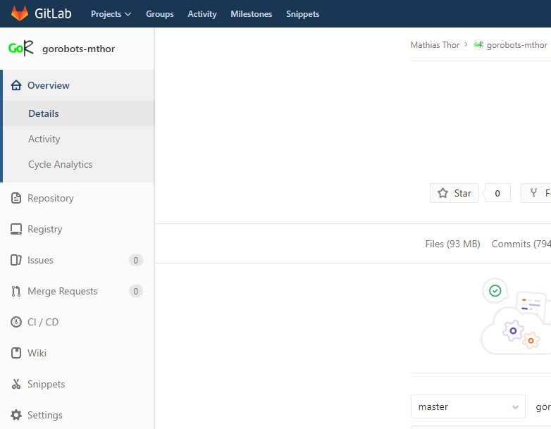
Starting your own project in GoRobots
As k for membership in ENS group on GitLa b (Koh, J an-Matthias, or Me)
Fork your version of GoRobots
Clone your fork to your Pc
Get pendulum s imula tion up and running by following the guide in the readme file
Start your own project and use the following s tructure
End your project with a merge request
Press this

Slide 49
Questions and Getting started
Any Ques tion?
Try getting the pendulum s im ula tion to run on your PC!

Slide 50
Installing VORTEX Physical engine
Go to: https :/ / www.cm -labs .com/ licens es /
Create free account
Go to: My Account > Downloa ds (the download page)
Pres s : Optiona l Downloa d > Vortex Studio (Linux)
Then go to: My Account > Licens es
Then reques t a licens e for Vortex Studio Es s entials
Extract the downloaded folder
Go to “Vortex_Studio…/ bin” (in the term ina l)
Then run “./ VortexLicens e Manager --a ctiva te KEY”
Res tart V-REP

Slide 51
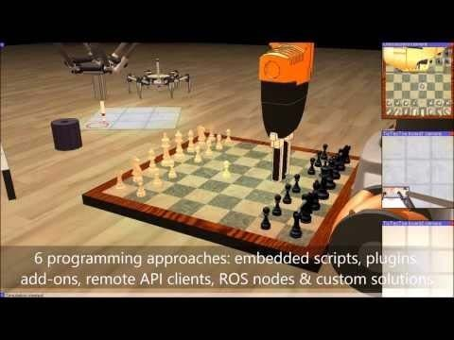
V-REP Overview
What is it?
General purpose robot s im ula tor with integra ted developm ent environment
What can it do ?
Sensors, mechanisms, robots and whole s ys tems can be modelled and s im ula ted in various ways
Typical applications ?
Fast prototyping and verifica tion Controller development
Hardware control
Simulation of factory automation systems Safety monitoring
Product presentation etc.

